Slide 2
Ronja Scholz, Iris Grobben, Pieter van Os

Slide 3
Explorative session May 31th 2023
Life Cycle Design
Life-Cycle Design is the environmentally sound design of products based on the whole lifecycle starting from exploitation and processing of raw materials, preproduction, production, distribution, to use and returning materials back into the industrial cycles.
Definition

Slide 4
Explorative session May 31th 2023
Life Cycle Design, blocks
Current status in design practice
Framework to scope Life Cycle Design elements
Applying the framework for two sectors
Conclusions and subject for further debate
Content of exploration

Slide 5
Explorative session May 31th 2023
Life Cycle Design, blocks
How do designers (= you) apply Life Cycle Design in their daily practice?
Validation of integrale design model on Life Cycle / circular design?
Two subjects for this exploratory session

Slide 6
Explorative session May 31th 2023
Life Cycle Design
Current status in design practice
Framework to scope Life Cycle Design elements
Applying the framework for two sectors
Conclusions and subject for further debate
Content of exploration

Slide 7
Let’s dive into LCD and have a quick brainstorm!
Pick a product (couch or consumer electronics) and discuss the following questions:
End-of-life: what is necessary to take it apart and reuse as much of the product as possible? What makes it easy / difficult?

Slide 8
Let’s dive into LCD and have a quick, explorative brainstorm!
Pick a product (couch or consumer electronics) and discuss the following questions:
End-of-life: what is necessary to take it apart and reuse as much of the product as possible? What makes it easy / difficult?
Use-phase: what is it the user could do during the lifetime to keep the product in the use-phase as long as possible?

Slide 9
Let’s dive into LCD and have a quick, explorative brainstorm!
Pick a product (couch or consumer electronics) and discuss the following questions:
End-of-life: what is necessary to take it apart and reuse as much of the product as possible? What makes it easy / difficult?
Use-phase: what is it the user could do during the lifetime to keep the product in the use-phase as long as possible?
Pre-use-phase (production): what design decisions are made that create these possibilities and difficulties?

Slide 10
Explorative session May 31th 2023
Life Cycle Design
Current status in design practice
Framework to scope Life Cycle Design elements
Applying the framework for two sectors
Conclusions and subject for further debate
Content of exploration

Slide 11
Introduction framework

Slide 12
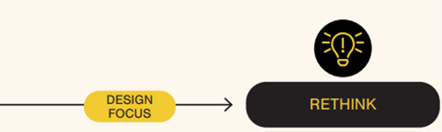
Explorative session May 31th 2023
Framework circular design, introduction
System level
Innovation for system level sustainability
Several products consolidated
Shared product use
Alternative product / packaging solution
MASTER CIRCULAR BUSINESS WITH THE VALUE HILL
Elisa Achterberg (Circle Economy & Sustainable Finance Lab), Jeroen Hinfelaar (CIRCO), Nancy Brocken (TU Delft)

Slide 13
Explorative session May 31th 2023v
Framework circular design, introduction
Low-impact materials
Responsibly sourced
Recycled
Rapidly renewable
Recyclable
Save (no substances of concern)
Minimal amount of material
Bio-materials (?)
Sourcing
MASTER CIRCULAR BUSINESS WITH THE VALUE HILL
Elisa Achterberg (Circle Economy & Sustainable Finance Lab), Jeroen Hinfelaar (CIRCO), Nancy Brocken (TU Delft)

Slide 14
Explorative session May 31th 2023
Framework circular design, introduction
Clean manufacturing
Efficient and safe
Less and renewable energy
Efficient software development
Production
Energy
Labour
Sourcing
MASTER CIRCULAR BUSINESS WITH THE VALUE HILL
Elisa Achterberg (Circle Economy & Sustainable Finance Lab), Jeroen Hinfelaar (CIRCO), Nancy Brocken (TU Delft)

Slide 15
Explorative session May 31th 2023
Framework circular design, introduction
Distribution
- Logistics
Efficient distribution and packaging
Lightweighting
Energy efficient logistics
Reduced volume packaging
Less/cleaner/reusable packaging
Recycled material
Production
Energy
Labour
Sourcing
MASTER CIRCULAR BUSINESS WITH THE VALUE HILL
Elisa Achterberg (Circle Economy & Sustainable Finance Lab), Jeroen Hinfelaar (CIRCO), Nancy Brocken (TU Delft)

Slide 16
Explorative session May 31th 2023
Framework circular design, introduction
Usage
Distribution
- Logistics
Use efficiency
Minimize power / fuel
Minimize indirect energy loss
Efficient/ clean use of consumables
Efficient/clean use of auxiliary materials
Production
Energy
Labour
Sourcing
Extended use
Reliability and durability
Upgradability and compatibility
Ease of maintenance and repair
Aging gracefully
Prevented premature obsolescence
MASTER CIRCULAR BUSINESS WITH THE VALUE HILL
Elisa Achterberg (Circle Economy & Sustainable Finance Lab), Jeroen Hinfelaar (CIRCO), Nancy Brocken (TU Delft)

Slide 17
Explorative session May 31th 2023
Framework circular design, introduction
Usage
Distribution
- Logistics
Recovery for reuse
Reuse direct of repurpose)
Refurbishment
Remanufacturing
Part harvesting
Production
Energy
Labour
Sourcing
End of life
Mechanical recycling
Chemical recycling
Composting
Incineration (?)
MASTER CIRCULAR BUSINESS WITH THE VALUE HILL
Elisa Achterberg (Circle Economy & Sustainable Finance Lab), Jeroen Hinfelaar (CIRCO), Nancy Brocken (TU Delft)

Slide 18
Explorative session May 31th 2023
Business model dimension
Business model dimension
What is the business incentive to apply life cycle design?
Various motivations;
Creating additional income /margin
Saving costs
Capturing value
Keeping access to resources
Complying with regulation
Matching customer demand (tendering)
Responding to public pressure (e.g. packaging)
Should compensate for additional investment / effort / risk

Slide 19
Explorative session May 31th 2023
Value system dimension
Value system dimension
What elements need to be arranged at a collective level?
Broad range of options;
Systems to close the loop
System management
Reversed logistics
Sorting and separating
Upcycling
Standards and quality controls
Capacity building
Digitization
Collaboration / coordination needed beyond individual player

Slide 20
Explorative session May 31th 2023
Elaboration on dimensions
Rethink
Business model
Not in interest current supplier
Alienating current channels
Value system
Symbiose with other industries
Additional capabilities

Slide 21
Explorative session May 31th 2023
Elaboration on dimensions
Sourcing and production
Business model
Price and quality of recycled material
Disturbance of yield in production
Value system
Non-traceability of hazardous substances
Additional activities for reusable packaging

Slide 22
Explorative session May 31th 2023
Elaboration on dimensions
(extended) Usage
Business model
Limited business incentive
Value system
o

Slide 23
Explorative session May 31th 2023
Elaboration on dimensions
End-of-use
Business model
High cost of logistics and labour
Low value of materials
Allocation costs
Value system
Efficient reversed loops

Slide 24
Explorative session May 31th 2023
Interaction, round 1
1. Additional design dimensions
Model is not only about product and service dimension, but also about business model and value system;
How do you currently deal with those dimensions?
Is the product and service dimension covered like this?
Are the added dimensions (business model and value system) relevant?
Is it feasible and desired to add those dimensions?
Should all dimensions be part of the design process?
What are strengths and weaknesses of the method?
Two topics for discussion

Slide 25
Explorative session May 31th 2023
CIRCO practise (SME-companies)

Slide 26
Explorative session May 31th 2023
Participant input, round 1
2. Scoping for individual companies
In practice we observe that most designers select / pick certain cells of the model instead of fully a integral design;
How does your company deal with this?
Is ‘cherry picking’ a sensible / pragmatic approach?
How to select the relevant cells?
Hot spot identification / mapping
What role can LCA play?
How to address / deal with the cells not selected?
Two topics for discussion

Slide 27
Explorative session May 31th 2023
Life Cycle Design
Current status in design practice
Framework to scope Life Cycle Design elements
Applying the framework for two sectors
Conclusions and subject for further debate
Content of exploration

Slide 28
(Design) challenges in electronic products

Slide 29
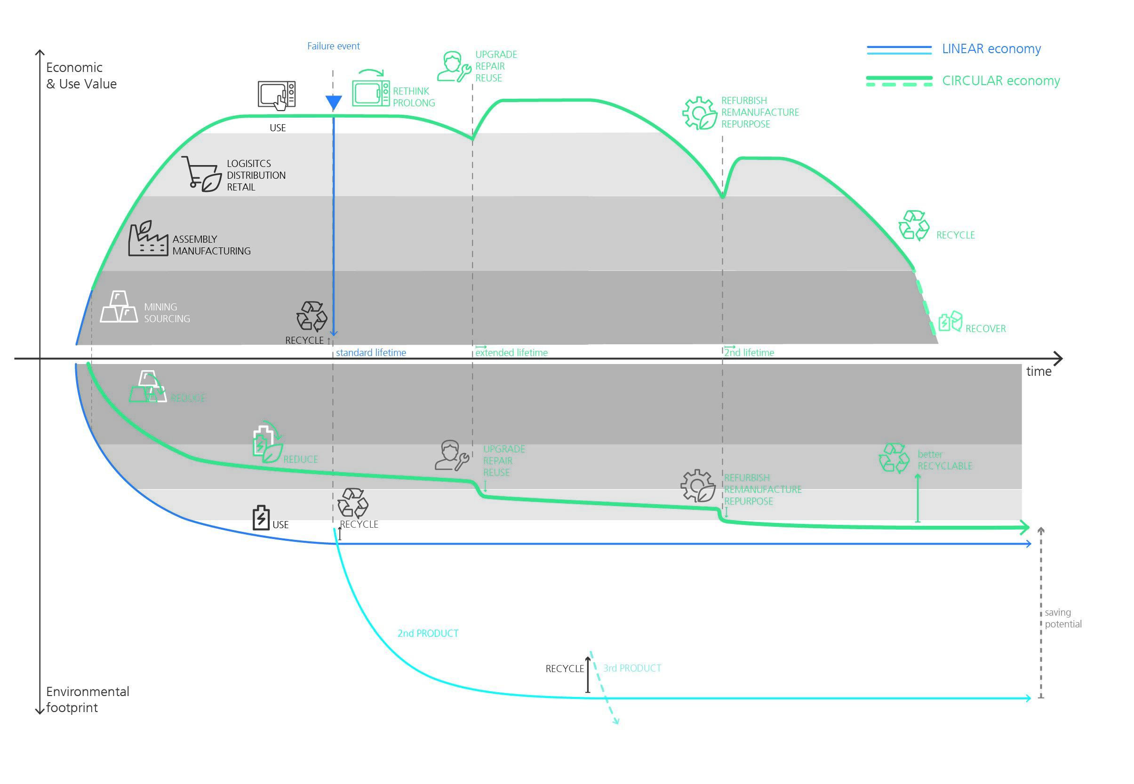
Understanding eco-cost along the
Life-cycle
© Ronja Scholz Fraunhofer IZM

Slide 30
Understanding hotspots
LCAs of white goods
 |  | GWP (%)
Product Group | Product Reference | Production | Use | Distrib. | EOL | Source
Vacuum Cleaner | Reference Canister VC | 26% | 77% | 2% | -5% | Gallego-Schmid et al. 2016
 | Reference Canister VC | 18% | 81% | 0% | 1% | Bobba et a. 2015
 | Reference Canister VC | 9% | 88% | 0% | 3% | Blepp et al. 2013
 | Reference Hand VC | 8% | 89% | 0% | 3%
 | Reference Battery VC | 28% | 62% | 0% | 9%
 | Reference Canister VC | 28% | 67% | 10% | -4% | Ramens et al. 2019
 | Reference Cordless VC | 33% | 63% | 7% | -4%
 | Reference Robot VC | 48% | 47% | 6% | -1%
Washing Machines | Reference horizontal-axis WM | 25% | 79% | 0% | -4% | Rüdenauer et al. 2005
 | Reference horizontal-axis WM | 42% | 74% | 2% | -18% | Yuan et al. 2016
 | Base Case WM | 19% | 81% | 3% | -2% | Boyano et al. 2017
Dishwasher | Standard Dishwasher (A) | 9% | 91% | 0% | 0% | Gensch et al. 2013
 | Standard Dishwasher (A+++)) | 13% | 87% | 0% | 0%
Fridge | Base Case household fridge | 18% | 82% | 6% | -6% | VHK et al. 2016
 | Base Case household fridge | 12% | 89% | 0% | -2% | Rüdenauer et al. 2007
Kettle | Electric Kettle | 7% | 92% | 1% | 1% | Marcinkowski et al. 2017
Coffee Machine | Nespresso | 40% | 47% | 8% | 5% | Quantis 2013
 | French Press | 10% | 88% | 0% | 2% | Brommer et al. 2011
 | Filter drip coffee maker | 14% | 78% | 0% | 8%
 | Fully automatic coffee | 6% | 90% | 0% | 4%
 | Pad filter machine with credit | 10% | 86% | 0% | 4%
 | Capsule (PP+Alu) with credit | 25% | 64% | 0% | 12%
 | Capsule (100% Alu) with credit | 25% | 69% | 0% | 7%
Source: Berwald et al. (2020) - Environmental evaluation of current and future design rules

Slide 31
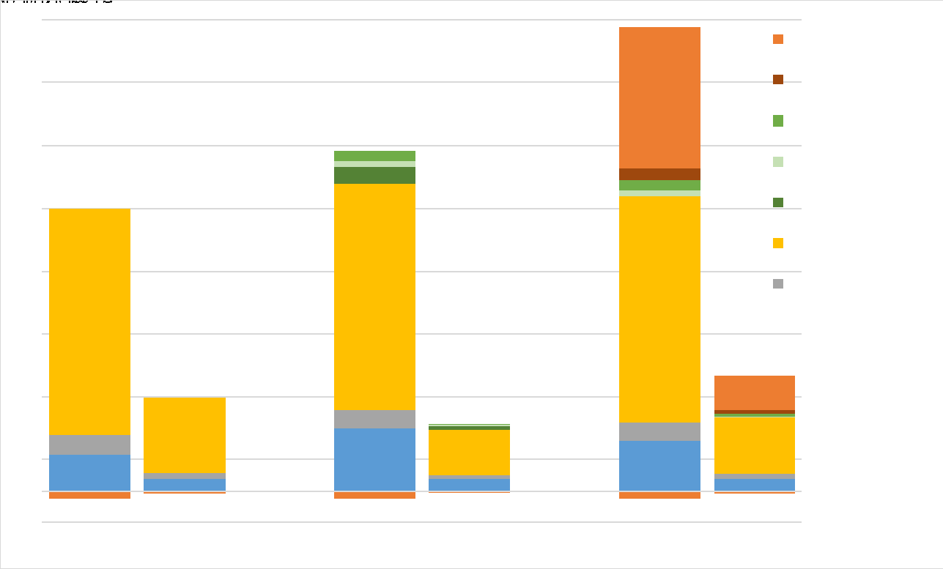
Understanding consequences
The Ecological Price of Modularity
Smartphone + functional upgrade
Smartphone + Repair
Smartphone
3 years use
5 years use
4 years use
Proske et. Al. (2016) “Life Cycle Assessment of the Fairphone 2”

Slide 32
Impact of high material & low emission vs low material & higher emission – and technical advancement
??? How much more efficient can a product get? In what time?
Environmental impact (CO2eq)
environmental impact in the use-phase (lower slope) due to more (energy/water) efficient new device
environmental impact from raw material production and manufacturing
Environmental break-even point
Usage
0
X
B

Slide 33
Circularity strategies may cause
targeting conflicts
Reference | Focus
CLC/TR 45550:2020 | Definitions
EN 45552:2020 | Durability (incl. reliability)
EN 45553:2020 | Remanufacture
EN 45554:2020 | Repair, reuse and upgrade
EN 45555:2019 | Recyclability and recoverability
EN 45556:2019 | Reused components
EN 45557:2020 | Recycled material content
EN 45558:2019 | Critical raw materials
EN 45559:2019 | Methods for providing information
45552
45556
45557
45558
45559
45554
45553
45555

Slide 34
Understanding LCAs
b2b Lighting
A question of interpretation
Unfortunately Data can’t be shared
Global warming potential
Abiotic resource depletion potentials
With the current design(s) REPAIR does not make sense: - from an ecological pov (transport) - from an economic pov (time & effort)

Slide 35
Interpreting LCAs
MedTech Component
A question of scope
Unfortunately Data can’t be shared
The task force could only improve designs within given dimensions, changing dimension for better exploitation of space is not an option

Slide 36
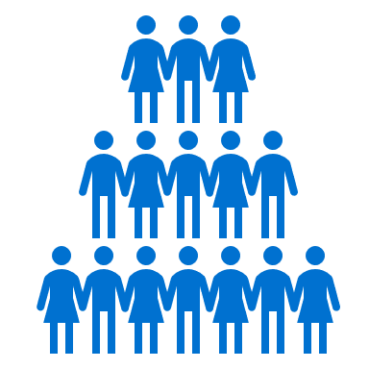
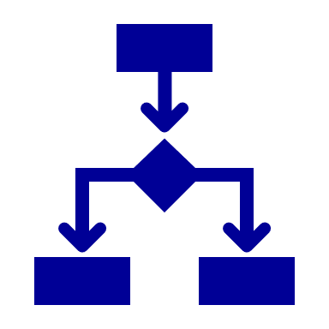
A question of scope & feasability
Team
Interdependencies & access
Influece

Slide 37
(Design) challenges in funiture

Slide 38
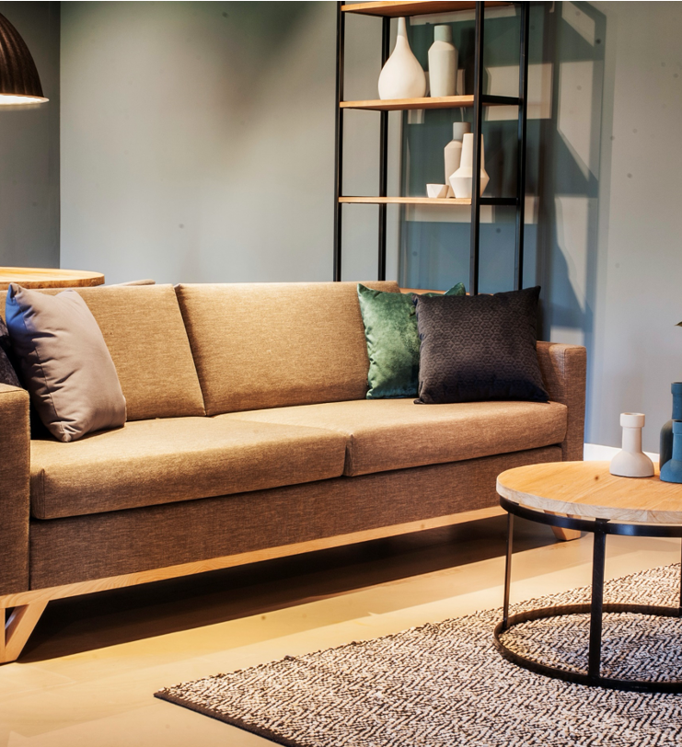
Business potential considerations for LCD
TNO Fingerprint method
How is value created?
How could it be preserved?
What 10 product properties play a role?
Technical life
Price per item
Repairability
Can the product use be planned
Modularity
Adaptivity
Recyclability
Frequency of use
Labor intensity
Sensitivity to fashion trends

Slide 39
Case of Landal | OT Design
Sourcing and material assessment done in-house
Short cycle, after 7 years end-of-life, sometimes earlier (technical life)
Furniture that is used intensively (frequency of use)
Fully glued and stapled (reparability)
Repair expensive (labor intensive)
Conclusion: value preservation is difficult

Slide 40
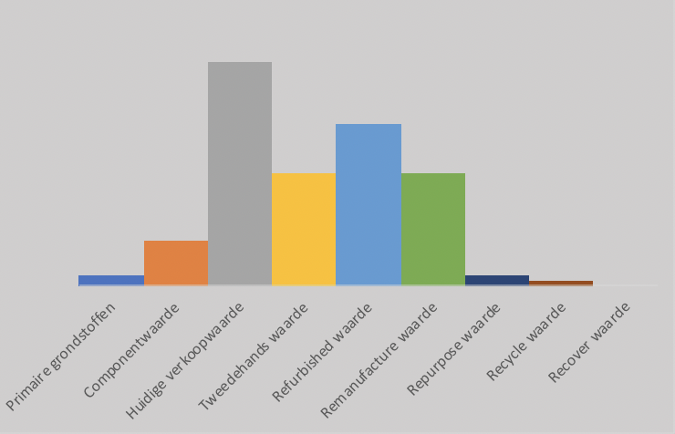
Business potential: value preservation
Resources
Components
Recycle value
Refurbished value
Repurpose value
Recover value
Second hand value
Current sales value
Remanufacture value

Slide 41
Business potential for multiple lifecycles
Resources
Components
Recycle value
Refurbished value
Repurpose value
Recover value
Second hand value
Current sales value
Remanufacture value

Slide 42
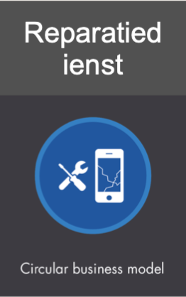
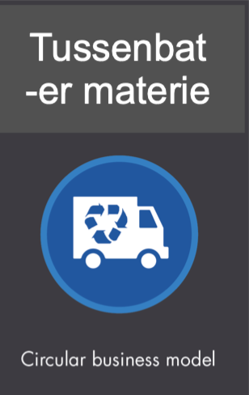
Classic long life
Repair
service
Technical life
Price per item
Repairability
Need to be planned
Modularity
Adaptivity
Recyclability
Frequency of use
Labor intensity
Sensitivity to fashion trends
Gap exploiter (recovery)
Resources
Components
Recycle value
Refurbished value
Repurpose value
Recover value
Second hand value
Current sales value
Remanufacture value

Slide 43
Explorative session May 31th 2023
Interaction, round 2
1. Business potential assessment
What would be the consequence when the business potential is also taken into consideration in project scoping
Are you already taking business potential into account?
Are the outcomes significantly different than without?
Dilemma; how to you rate;
An intervention with a high environmental impact but limited probability of implementation because of a low business potential versus
A lower environmental impact with a high probability of implementation because of a high business potential
First topics for discussion

Slide 44
Sector challenges

Slide 45
Sector specific product and service challenges
Design elements
Recycled or biobased material
Efficient production
Environmental impact usage
Replacement triggers
First use extension options
Product re-use
Product collection
End-of-use treatment
Electronics challenge
Global plastic value chain
PCB are standardised
Yield driven industrial process
Energy consumption
New generation tech push
Defects
Functioning within a system
No DIY repair, prof system needed
Software upgrades possible
Technical obsolescence
Limited demand, complex logistics
Open loop system required
Systems differ per country
Shredding and material recover
Furniture challenge
Local sourcing for wood
Long chain for textiles
Local more flexible production
Cleaning hard to influence
Need push from trends / fashion
Defects
Restyling of entire interior
Limited DIY, Replacement of cover
Graceful aging / user attachment
Broad variety of products
No specific system. Waste collection
No standard treatment, Incineration

Slide 46
Sector specific business model challenges
Design element
Cost saving
Efficient production
Customer relation
Adding paid service
Repair options
‘As a service’ option
Product re-use / component harvest
Material re-use
Electronics challenge
Focus in industry
Long optimized value chain
Risk avoiding attitude
Brand based
Retail or other channel
Variety of markets
Powerful content industry
Incentive for prof system
Spare parts
Aggregator needed
Complex volume game
Closed loop needed
Not for individual supplier
Furniture challenge
Supplier specific
Mostly in circle of influence
Flexible
Product based
Less massive channels
Closer to market
Not used to services
Service option
Possible but paradigm shift

Slide 47
Sector specific value system challenges
Design element
Design for recycling
Use of recycled materials
Repair
End-of-use logistics
Electronics challenge
Country specific recycling process
Predictable quantities
Consistent quality
No DIY, infra for repair and spare parts
Open loop system
Challenge for sorting
Not designed for disassembly
Furniture challenge
No process in place yet
Textiles on national level
Wood from multiple sources
Closed loop possible
Size a limiting factor

Slide 48
Explorative session May 31th 2023
Interaction, round 2
2. Sector characteristics
Based on provisional sketch of challenges for the two sectors;
First feedback on the design challenges as formulated per sector / your sector
On what level (sector, product category, product, component) should or could this input be defined?
Is this sector input relevant and of added value for life cycle considerations?
E.g. how to deal with broad range of challenges on value system level?
Are there consequences of this differentiation regarding design process, -capabilities and -inputs
second topic for discussion

Slide 49
What more is to be discussed

Slide 50
Explorative session May 31th 2023
Life Cycle Design
Current status in design practice
Framework to scope Life Cycle Design elements
Applying the framework for two sectors
Conclusions and subject for further debate
Content of exploration

